Slide 1
TAMU-GoldWind Project2 Report
06-14-2019
Prepared By
Nitesh Kumar

Slide 2
Introduction
What we did previously
Use the kNN method for power curve modelling and analysis of the followings:
  - 10 minute average data
  - 1 minute average data
  - Down sample 1 minute and average 10 minute data
Two modeling options: using generator speed and without generator speed
The forward stepwise method along with 10 fold cross validation were employed to get the best covariates combination
Transition from KNN to Gaussian Process (GP) Model. Why do we need this?
Most of the data encountered on daily basis exhibits stochastic behavior and gaussian process is based on stochastic principle.
KNN is a nonparametric approach focusing on predicting/estimating a mean (average) value without uncertainty quantification.
Gaussian process can quantify the uncertainty or change easily because it assumes a joint multivariate Gaussian distribution.

Slide 3
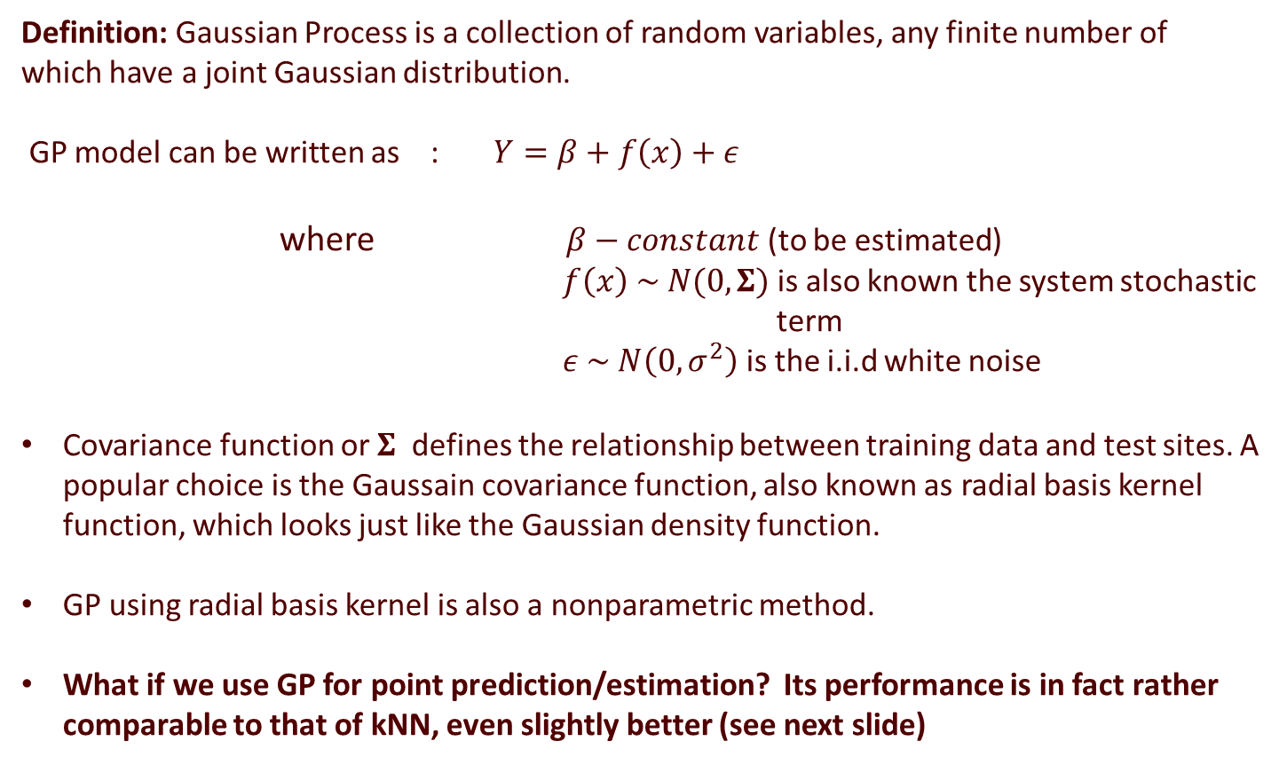
GP Model
Definition: Gaussian Process is a collection of random variables, any finite number of which have a joint Gaussian distribution.
GP model can be written as : $Y=β+f\left(x\right)+ε$
where $β−constant$ (to be estimated)
$f\left(x\right) \sim N(0,Σ)$ is also known the system stochastic
term
$ε \sim N\left(0,σ^{2}\right)$ is the i.i.d white noise
Covariance function or $Σ$ defines the relationship between training data and test sites. A popular choice is the Gaussain covariance function, also known as radial basis kernel function, which looks just like the Gaussian density function.
GP using radial basis kernel is also a nonparametric method.
What if we use GP for point prediction/estimation? Its performance is in fact rather comparable to that of kNN, even slightly better (see next slide)

Slide 4
KNN vs GP Model (mean prediction)
Model | Turbine – 34 (2016) RMSE(%) | Turbine – 34 (2018) RMSE(%) | Turbine – 61 (2018) RMSE(%)
KNN – 10 mins (average) | 2.07% | 1.98 % | 1.70 %
GP – 10 mins (average) | 1.63% | 1.96% | 1.40%
BINNING – 10 mins (average) | 3.93% | 4.37% | 3.94 %
% reduction from Binning (KNN) | 47% | 55% | 57%
% reduction from Binning (GP) | 58% | 55% | 64%
Best variable sets | W, G, T, Ang | W, T, G | W, T, G, I

Slide 5
Introduction
What we do here
Use GP to do performance comparison either between two periods of the same turbine or two turbines over the same period.
The methodology background for doing this is hypothesis testing of two nonparametric functions.

Slide 6
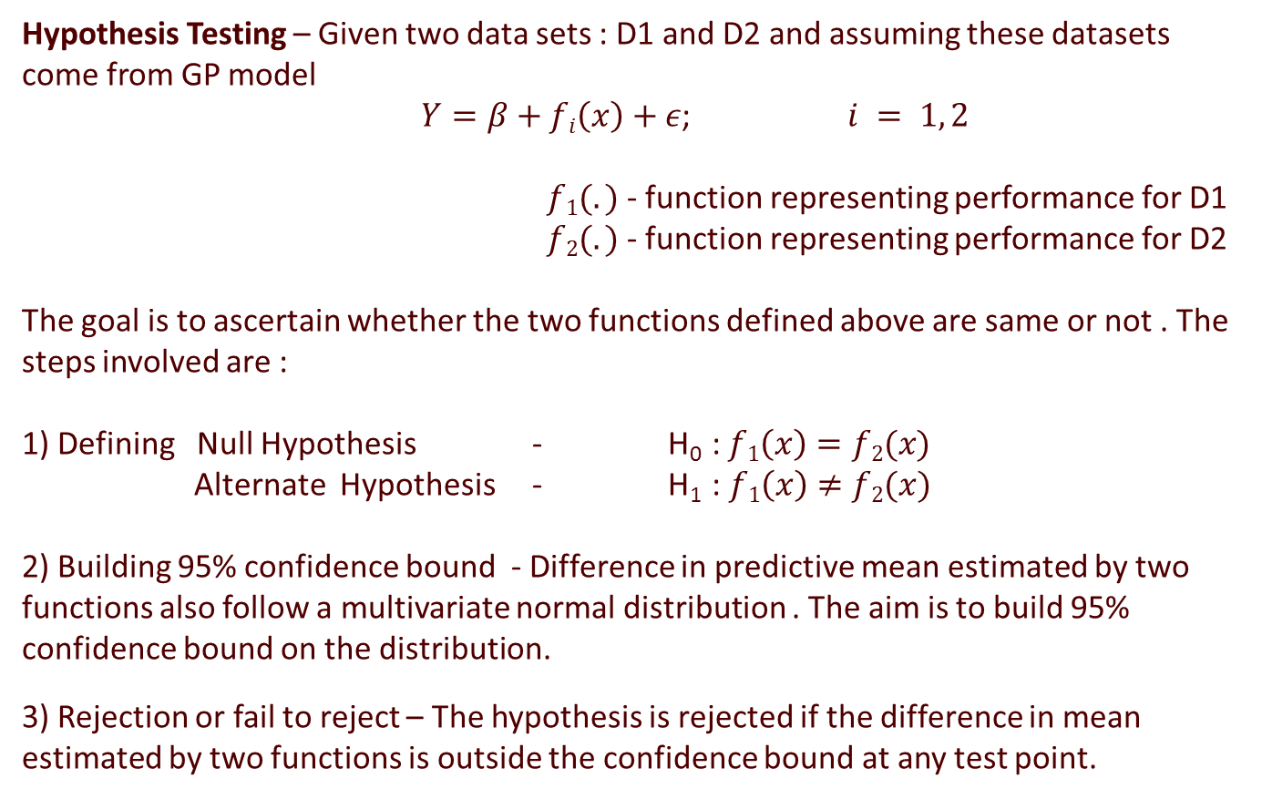
GP Model - Statistical Inference
Hypothesis Testing – Given two data sets : D1 and D2 and assuming these datasets come from GP model
$Y=β+fi\left(x\right)+ε$; $i = 1, 2$
$f1(.)$ - function representing performance for D1
$f2(.)$ - function representing performance for D2
The goal is to ascertain whether the two functions defined above are same or not . The steps involved are :
1) Defining Null Hypothesis - H₀ : $f1\left(x\right)=f2(x)$
Alternate Hypothesis - H₁ : $f1\left(x\right)≠f2(x)$
2) Building 95% confidence bound - Difference in predictive mean estimated by two functions also follow a multivariate normal distribution . The aim is to build 95% confidence bound on the distribution.
3) Rejection or fail to reject – The hypothesis is rejected if the difference in mean estimated by two functions is outside the confidence bound at any test point.

Slide 7
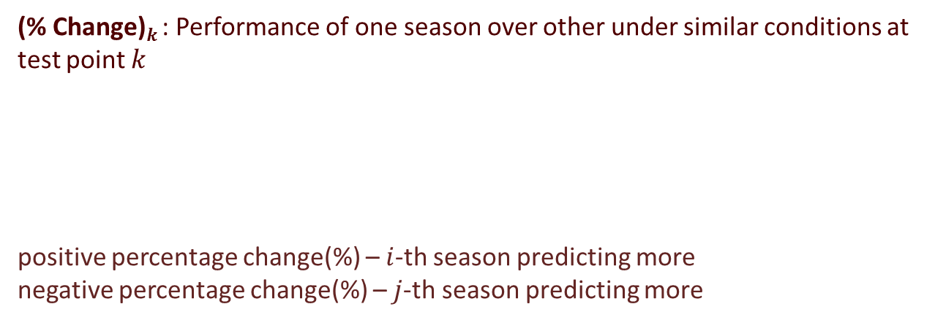
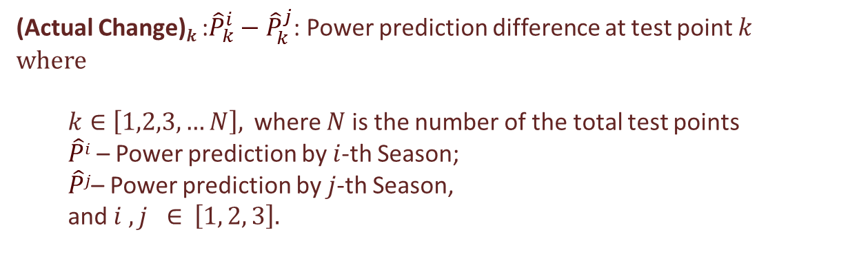

GP Model - Quantification
1)
(Actual Change)$k$ :${\hat{P}}_{k}^{i}−{\hat{P}}_{k}^{j}$: Power prediction difference at test point $k$
where
$k∈$ $\left[1,2,3,…N\right],$ where $N$ is the number of the total test points
  $\hat{P}i$ – Power prediction by $i$-th Season;
  $\hat{P}j$– Power prediction by $j$-th Season,
  and $i , j ∈$ $\left[1, 2, 3\right].$
2)
(% Change)$k$ : Performance of one season over other under similar conditions at test point $k$
positive percentage change(%) – $i$-th season predicting more
negative percentage change(%) – $j$-th season predicting more
$$\frac{{\hat{P}}_{k}^{i}−{\hat{P}}_{k}^{j}}{{\hat{P}}_{k}^{j}}∗100$$

Slide 8
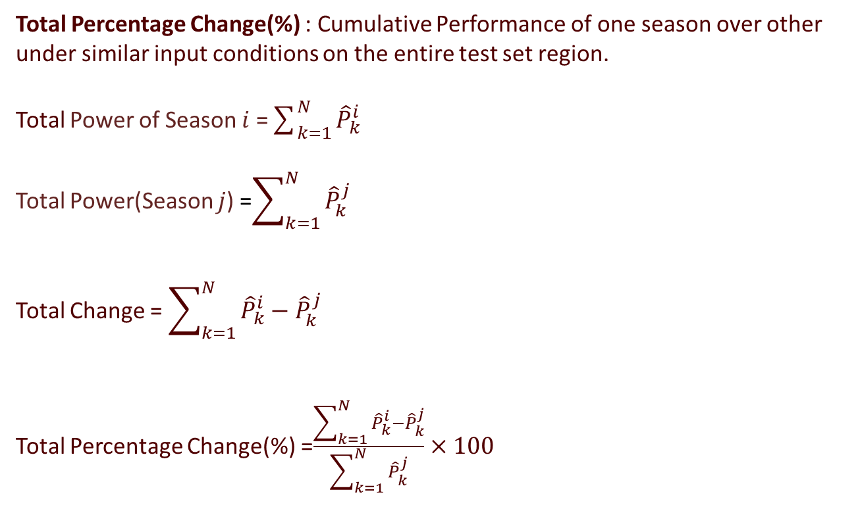
3)
Total Percentage Change(%) : Cumulative Performance of one season over other under similar input conditions on the entire test set region.
Total Power of Season $i$ =$\sum_{k=1}^{N}{{\hat{P}}_{k}^{i}}$
Total Power(Season $j$) =$\sum_{k=1}^{N}{{\hat{P}}_{k}^{j}}$
Total Change = $\sum_{k=1}^{N}{{\hat{P}}_{k}^{i}−{\hat{P}}_{k}^{j}}$
Total Percentage Change(%) =$\frac{\sum_{k=1}^{N}{{\hat{P}}_{k}^{i}−{\hat{P}}_{k}^{j}}}{\sum_{k=1}^{N}{{\hat{P}}_{k}^{j}}}×100$

Slide 9
Definitions and Methodologies
Test Sets : They play a key role in comparing two seasons given a fixed domain.
The steps of creating test points :
Selecting the same covariates as used in training the model.
Selecting the domain of each covariates( for example wind speed – 3 to 13 m/s)
Dividing the domain of each covariates in N equal parts(where N is called regular grid)
Finally taking every combination of these divided sub points(N*N total combination)
Every test point = (Cov1 , Cov2)
where Cov1 – Covariate 1 and Cov2- Covariate2
Demonstration of test points given the covariates wind speed and ambient temperature and regular grid 50
Domain of wind speed : 3 to 13 (m/s) so grid -> (3,3.2,3.4,3.6……..13)
Domain of ambient temperature : 0 to 30 (C) so grid -> (0,0.6,0.12,0.18…..30)
Test Point 1 – (3,0) ……………………………………………Test Point 2500 – (13,30)

Slide 10
Bound : The maximum limit of power prediction difference between two seasons under similar input conditions at a given confidence level (95%)
Performance Metrics :
Metric 1 - The performance of one season over other. This accounts for the gain-
- ( % change and Total change %) of one season over other in the prediction of target ( Power) given the same input parameters
Metric 2 – Is there a statistical difference in two seasons?. This accounts for hypothesis testing at every test input. The methodology involves defining a 95% confidence bound. The seasons are said to statistically differ if the power prediction difference(absolute( Actual Change)) at any test point exceeds the given Bound .

Slide 11
Gaussian Process - Seasonality Comparison
Data-set : 2016
Train - Set
Data-set | Time-Period | Number of Observations | Seasons
1 | Jan - March | 7310 | Season 1
2 | April - June | 8809 | Season 2
3 | July - September | 9989 | Season 3
Models
Comparison – Test set
Model | Covariates
1 | W + T
2 | G + T
3 | W + G
Model | Test - Set
1 | 2500 test points
2 | 2500 test points
3 | 2500 test points

Slide 12
Model 1
Test – Set(2500 test points)
Covariates | Range | Regular Grid
Wind Speed | 3 – 13 (m/s) | 50
Ambient temperature | 0 – 30 (C) | 50
Comparison
Comparison | Data-set | Data-set
1 | Data-set 1 | Data-set 2
2 | Data-set 2 | Data-set 3
3 | Data-set 1 | Data-set 3

Slide 13
Seasonality Behavior
Power (kW)
Wind Speed (m/s)

Slide 14

Power (kW)
Ambient Temperature ($°C$)

Slide 15

Performance Metrics
Metric 1 – Season 1 and Season 2
% Change
Wind Speed(m/s)
% Change
Total change predicted by Season 1 over Season 2 : 4.33 %
Ambient Temperature($°C$)

Slide 16
Metric 2 – Season 1 and Season 2
Power (kW)
Wind Speed (m/s)
78 % of test points are above the bound - statistically season 1 and 2 are different

Slide 17

Metric 1 – Season 2 and 3
% Change
Wind Speed(m/s)
% Change
Total change predicted by Season 2 over Season 3 - 2.99 %
Ambient Temperature($°C$)

Slide 18
Metric 2 – Season 2 and Season 3
Power (kW)
Wind Speed (m/s)
78 % of test points are above the bound - statistically season 2 and 3 are different

Slide 19

Metric 1 – Season 1 and Season 3
% Change
Wind Speed(m/s)
% Change
Total change predicted by Season 1 over Season 3 - 7.84 %
Ambient Temperature($°C$)

Slide 20
Metric 2 – Season 1 and Season 3
Power (kW)
Wind Speed (m/s)
88 % of test points are above the bound - statistically season 1 and 3 are different

Slide 21
Model 2
Test – Set(2500 test points)
Covariates | Range | Regular Grid
Generator Speed | 7.5 – 17.5 (rpm) | 50
Ambient temperature | 0 – 30 (C) | 50
Comparison
Comparison | Data-set | Data-set
1 | Data-set 1 | Data-set 2
2 | Data-set 2 | Data-set 3
3 | Data-set 1 | Data-set 3

Slide 22
Seasonality Behavior
Power (kW)
Generator Speed (rpm)

Slide 23

Power (kW)
Ambient Temperature ($°C$)

Slide 24

Performance Metrics
Metric 1 – Season 2 and Season 1
% Change
Generator Speed (rpm)
% Change
Total change predicted by Season 2 over Season 1 - 1.34 %
Ambient Temperature ($°C$)

Slide 25
Metric 1 – Season 2 and Season 1
Power (kW)
Generator Speed (rpm)
10 % of test points are above the bound - statistically season 1 and 2 are different

Slide 26

Metric 1 – Season 2 and Season 3
% Change
Generator Speed (rpm)
% Change
Total change predicted by Season 2 over Season 3 - 1.85 %
Ambient Temperature($°C$)

Slide 27
Metric 2 – Season 2 and Season 3
Power (kW)
Generator Speed (rpm)
6 % of test points are above the bound - statistically season 2 and 3 are different

Slide 28

Metric 1 – Season 1 and Season 3
% Change
Generator Speed (rpm)
% Change
Total change predicted by System 1 over System 3 - 0.50 %
Ambient Temperature ($°C$)

Slide 29
Metric 1 – Season 1 and Season 3
Power (kW)
Generator Speed (rpm)
4 % of test points are above the bound - statistically season 1 and 3 are different

Slide 30
Model 3
Test – Set(2500 test points)
Covariates | Range | Regular Grid
Wind Speed | 3 – 13 (m/s) | 50
Generator Speed | 9.5 – 17.5 (rpm) | 50
Comparison
Comparison | Data-set | Data-set
1 | Data-set 1 | Data-set 2
2 | Data-set 2 | Data-set 3
3 | Data-set 1 | Data-set 3

Slide 31
Seasonality Behavior
Power (kW)
Wind Speed (m/s)

Slide 32
Power (kW)
Generator Speed (rpm)

Slide 33
Performance Metrics
Metric 1 – Season 1 and 2
% Change
Wind Speed (m/s)
% Change
Total change predicted by Season 1 over Season 2 : 4.74 %
Generator Speed (rpm)

Slide 34
Metric 2 – Season 1 and 2
Power (kW)
Wind Speed (m/s)
80 % of test points are above the bound - statistically season 1 and 2 are different

Slide 35
Metric 1 – Season 2 and 3
% Change
Wind Speed (m/s)
% Change
Total change predicted by Season 2 over Season 3 : 2.96 %
Generator Speed (rpm)

Slide 36
Metric 2 – Season 2 and 3
Power (kW)
Wind Speed (m/s)
84 % of test points are above the bound - statistically season 2 and 3 are different

Slide 37
Metric 1 – Season 1 and 3
% Change
Wind Speed (m/s)
% Change
Total change predicted by Season 1 over Season 3 : 7.84 %
Generator Speed (rpm)

Slide 38
Metric 2 – Season 1 and 3
Power (kW)
Wind Speed (m/s)
94 % of test points are above the bound - statistically season 1 and 3 are different

Slide 39
Summary
Metric 1
 | Season 1 over Season 2 | Season 2 over Season 3 | Season 1 over Season 3
Total Change (%) under model 1 (W+T) | 4.33 % | 2.99 % | 7.84%
Total Change (%) under model 2 (G+T) | (-1.34 %)* | 1.85 % | 0.5 %
Total Change (%) under model 3 (W+G) | 4.74% | 2.96 % | 7.84 %
Total Change (%) under Binning method | 4.73 % | 2.96 % | 7.84 %
*Note :- Model 2 predicts more for season 2 over season 1 so (-1.34 %) means positive change predicted by season 2 over season 1 by 1.34 %

Slide 40
Metric 2
 | Season 1 and Season 2 | Season 2 and Season 3 | Season 1 and Season 3
% test points above the bound (W+T) | 78 % | 78 % | 88 %
% test points above the bound (G+T) | 10 % | 6.0 % | 4.0 %
% test points above the bound (W+G) | 80 % | 84 % | 94 %
Significant Difference(W+T), (G+T), (W+G)? | Yes | Yes | Yes

Slide 41
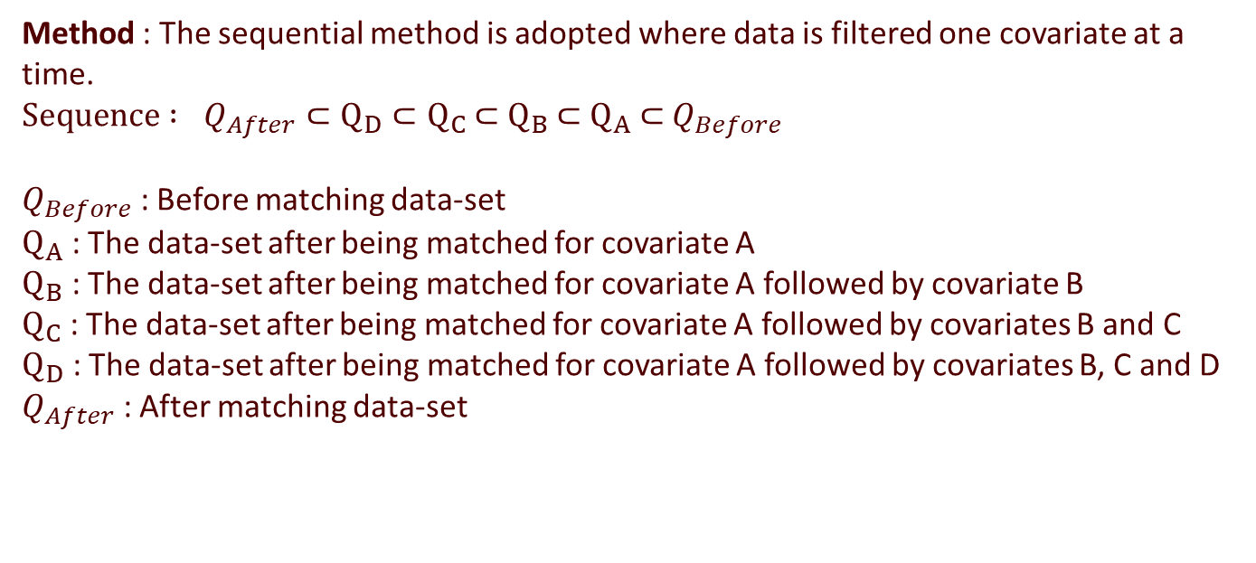
Covariates Matching
Covariates Matching :The difficulty in quantifying the actual effect of environmental conditions paves way for a controlled experiment where the environmental features are screened to almost give a similar distribution for all the time periods in comparison.
Method : The sequential method is adopted where data is filtered one covariate at a time.
${Sequence : Q}_{After}⊂Q_{D}$ $⊂Q_{C}$ $⊂$ $Q_{B}$ $⊂$ $Q_{A}$ $⊂$ $Q_{Before}$
$Q_{Before}$ : Before matching data-set
$Q_{A}$ : The data-set after being matched for covariate A
$Q_{B}$ : The data-set after being matched for covariate A followed by covariate B
$Q_{C}$ : The data-set after being matched for covariate A followed by covariates B and C
$Q_{D}$ : The data-set after being matched for covariate A followed by covariates B, C and D
$Q_{After}$ : After matching data-set

Slide 42
Covariates used for matching :
Wind speed
Wind Direction
Ambient Temperature
Turbulence Intensity
Before covariate matching:
Data-set 1 : 23275 observations
Data-set 2 : 28421 observations
Data-set 3 : 32511 observations
After covariate matching:
Data-set 1 : 1158 observations
Data-set 2 : 1158 observations
Data-set 3 : 1158 observations
Model used : Gaussian Process

Slide 43
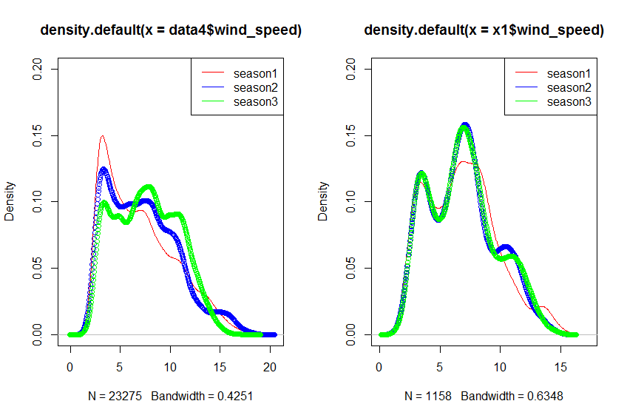
Before matching
After matching
Wind speed (m/s)
Wind speed (m/s)

Slide 44
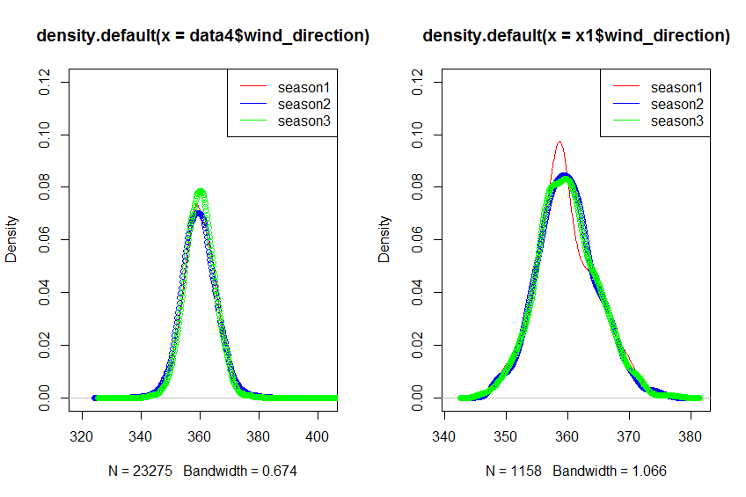


Before matching
After matching
Wind direction$(θ)$
Wind direction$(θ)$

Slide 45
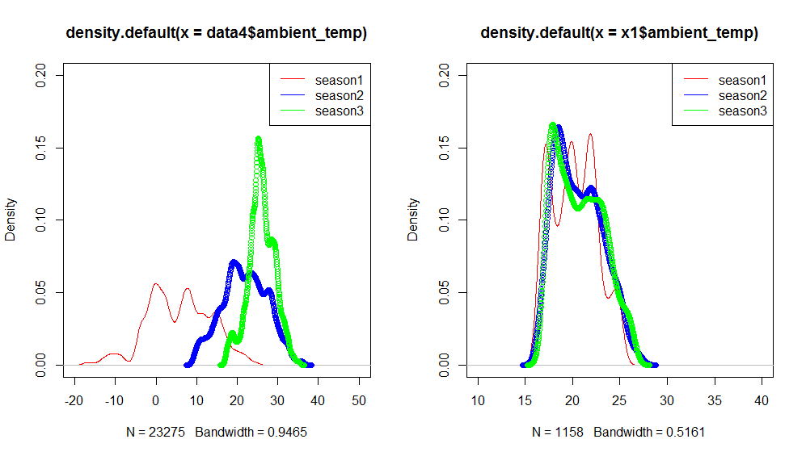


Before matching
After matching
Ambient temperature$(°C)$
Ambient temperature$(°C)$

Slide 46
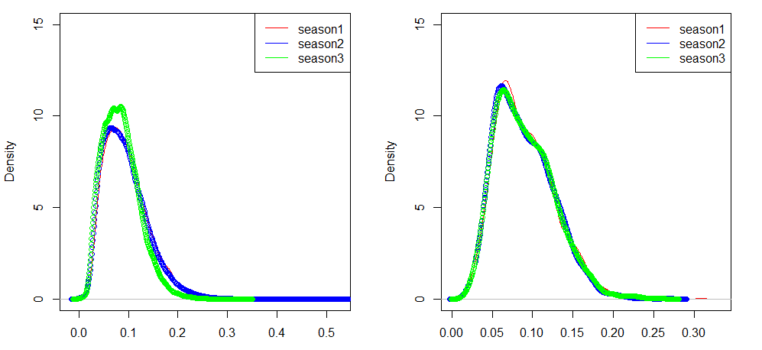
Before matching
After matching
Turbulence intensity
Turbulence intensity

Slide 47
Gaussian Process - Seasonality Comparison
Data-set : 2016
Train - Set
Data-set | Time-Period | Number of Observations | Seasons
1 | Jan - March | 1158 | Season 1
2 | April - June | 1158 | Season 2
3 | July - September | 1158 | Season 3
Models
Comparison – Test set
Model | Covariates
1 | W + T
2 | G + T
Model | Test - Set
1 | 2500 test points
2 | 2500 test points

Slide 48
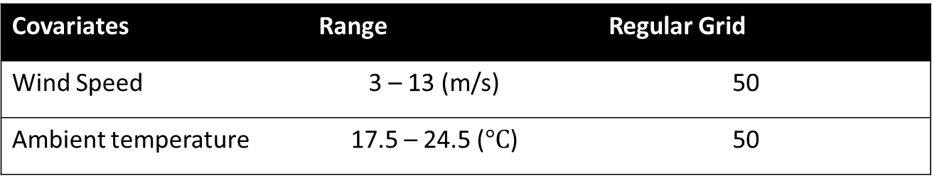
Model 1
Test – Set(2500 test points)
Covariates | Range | Regular Grid
Wind Speed | 3 – 13 (m/s) | 50
Ambient temperature | 17.5 – 24.5 ($°C$) | 50
Comparison
Comparison | Data-set | Data-set
1 | Data-set 1 | Data-set 2
2 | Data-set 2 | Data-set 3
3 | Data-set 1 | Data-set 3

Slide 49
Seasonality Behavior
Power (kW)
Wind Speed (m/s)

Slide 50
Power (kW)
Ambient Temperature ($°C$)

Slide 51
Performance Metrics
Metric 1 – Season 1 and Season 2
% Change
Wind Speed(m/s)
% Change
Total change predicted by Season 1 over Season 2 : 3.28 %
Ambient Temperature($°C$)

Slide 52
Metric 2 – Season 1 and Season 2
Power (kW)
Wind Speed (m/s)
64 % of test points are above the bound - statistically season 1 and 2 are different

Slide 53

Metric 1 – Season 2 and 3
% Change
Wind Speed(m/s)
% Change
Total change predicted by Season 2 over Season 3 - 1.9 %
Ambient Temperature($°C)$

Slide 54
Metric 2 – Season 2 and Season 3
Power (kW)
Wind Speed (m/s)
34 % of test points are above the bound - statistically season 2 and 3 are different

Slide 55

Metric 1 – Season 1 and Season 3
% Change
Wind Speed(m/s)
% Change
Total change predicted by Season 1 over Season 3 - 5.24 %
Ambient Temperature($°C$)

Slide 56
Metric 2 – Season 1 and Season 3
Power (kW)
Wind Speed (m/s)
62 % of test points are above the bound - statistically season 1 and 3 are different

Slide 57

Model 1
Test – Set(2500 test points)
Covariates | Range | Regular Grid
Wind Speed | 3 – 13 (m/s) | 50
Generator Speed | 10 – 16.5 ($rpm$) | 50
Comparison
Comparison | Data-set | Data-set
1 | Data-set 1 | Data-set 2
2 | Data-set 2 | Data-set 3
3 | Data-set 1 | Data-set 3

Slide 58
Seasonality Behaviour
Power (kW)
Wind Speed (m/s)

Slide 59
Power (kW)
Ambient Temperature ($°C$)

Slide 60

Performance Metrics
Metric 1 – Season 1 and Season 2
% Change
Wind Speed(m/s)
% Change
Total change predicted by Season 2 over Season 1 : 0.14 %
Ambient Temperature($°C$)

Slide 61
Metric 2 – Season 1 and Season 2
Power (kW)
Wind Speed (m/s)
No test points are above the bound - statistically season 1 and 2 are similar

Slide 62
Metric 1 – Season 2 and 3
% Change
Wind Speed(m/s)
% Change
Total change predicted by Season 2 over Season 3 - 0.82 %
Ambient Temperature($°C)$

Slide 63
Metric 2 – Season 2 and Season 3
Power (kW)
Wind Speed (m/s)
No test points are above the bound - statistically season 2 and 3 are similar

Slide 64
Metric 1 – Season 1 and Season 3
% Change
Wind Speed(m/s)
% Change
Total change predicted by Season 1 over Season 3 - 0.68 %
Ambient Temperature($°C$)

Slide 65
Metric 2 – Season 1 and Season 3
Power (kW)
Wind Speed (m/s)
No test points are above the bound - statistically season 1 and 3 are similar

Slide 66
Summary
Metric 1
 | Season 1 over Season 2 | Season 2 over Season 3 | Season 1 over Season 3
Total Change (%) under model 1 (W+T) | 3.28 % | 1.90 % | 5.24%
Total Change (%) under model 2 (G+T) | 0.14 % | 0.82 % | 0.68 %
Total Change (%) under Binning method | 3.36 % | 1.93 % | 5.36 %

Slide 67
Metric 2
 | Season 1 and Season 2 | Season 2 and Season 3 | Season 1 and Season 3
% test points above the bound (W+T) | 64 % | 34 % | 62 %
% test points above the bound (G+T) | 0.0 % | 0.0 % | 0.0 %
Significant Difference(W+T) ? | Yes | Yes | Yes
Significant Difference(G+T) ? | No | No | No

